Slide 1
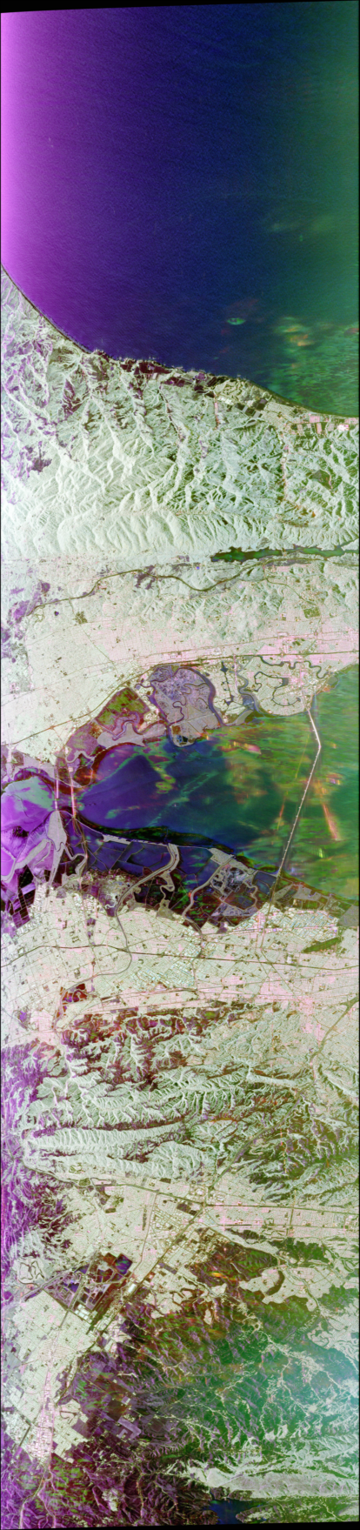
Measuring and Enhancing the Visual Content of Polarimetric Synthetic Aperture Radar Decompositions
Ulile Indeque¹, Alejandro C. Frery²
Laboratório de Computação Científica e Análise Numérica - UFAL¹
School of Mathematics and Statistics, Victoria University of Wellington, New Zealand²

Slide 2
Content
Introduction
Methodology
Results
Conclusion

Slide 3
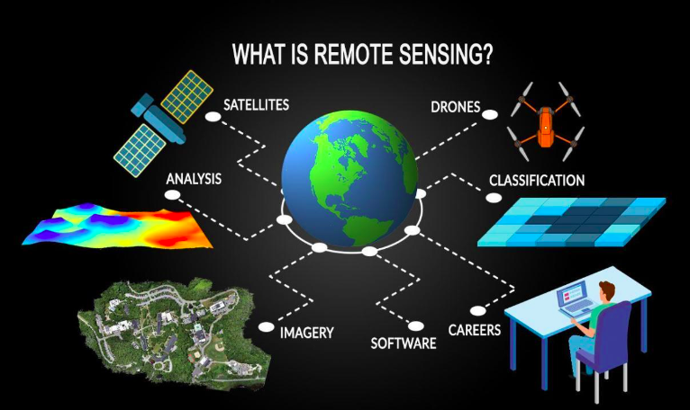
Introduction
What is the SAR image?
Image which obteined by remote sensing;
It's the result of the scene in several combinations of transmitting
and receiving polarization of the electromagnetic waves;
Formed by 2D-array complex of values;
https://gisgeography.com/remote-sensing-earth-observation-guide/

Slide 4
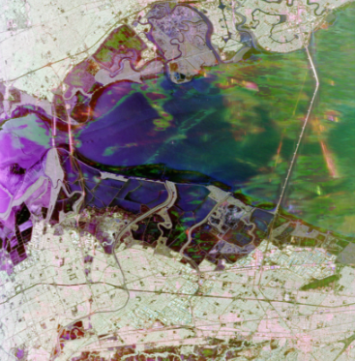
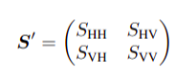
Introduction
What is the SAR image?
The observation in each pixel of a fully polarimetric image is a 2 × 2 complex-valued, that can be represented by the scattering matrix
http://uavsar.jpl.nasa.gov/cgi-bin/product.pl?jobName=Haywrd_05523_21060_006_211020_L090_CX_01

Slide 5

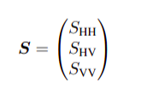
Introduction
What is the SAR image?
Under the reciprocity principle, HV=VH, so the information in the scattering matrix can be encoded in the scattering vector, as follow

Slide 6
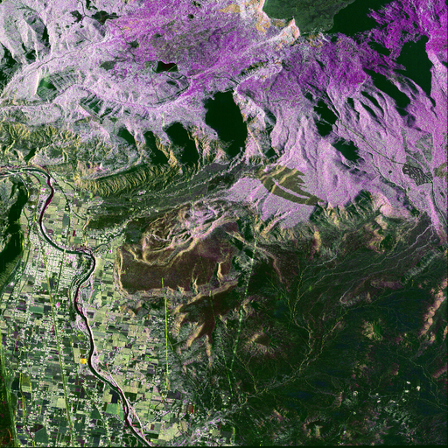
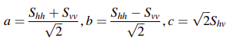
Introduction
Decomposition process
The decomposition theorems allow us to deal with several visualization types, such as:
Pauli decomposition;
Krogager decomposition;
Hyunem decomposition;
Pauli components
Visualization in pauli decomposition

Slide 7
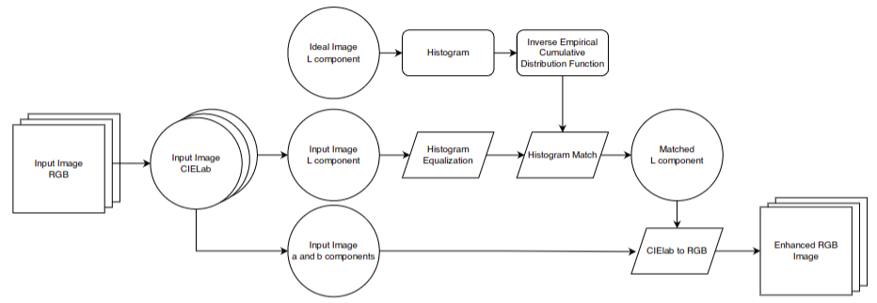
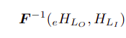
Methodology
Matching histogram

Slide 8
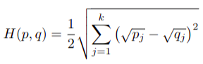
Methodology
Metric
Hellinger distance

Slide 9
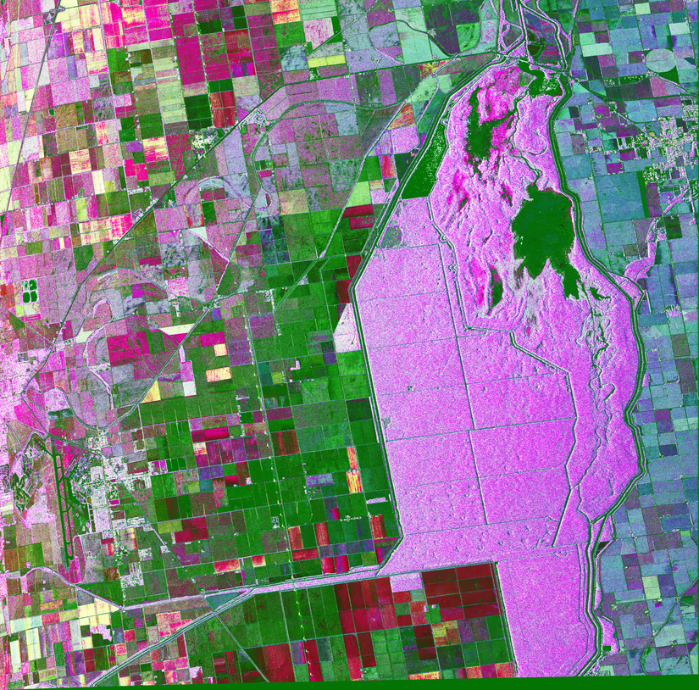
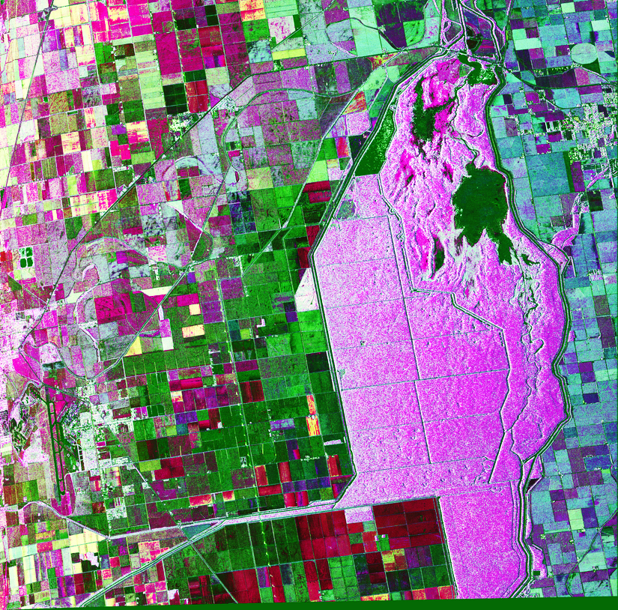
Results
Original Pauli Decomposition
Pauli Decomposition improved by Equalization method
a)
b) H(Ideal, Equalized) = 0.186

Slide 10
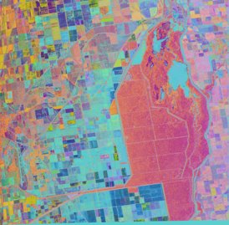
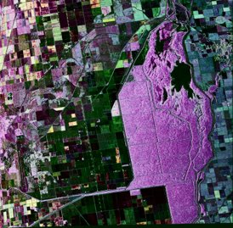
Resuts
Pauli Decomposition improved by Decorrelation method
Pauli Decomposition improved by Matching histogram method
c) H(Ideal,Decoralation) = 0.299
d) H(Ideal, Improved) = 0.330

Slide 11
Conclusion
The presented technique improves the image, preserving the properties;
Improved image by matching histogram is more realistic than others;
The three first have crisp and highly saturated colors;
The c) produces colors which are not interpretable in terms of a Pauli decomposition;
Future works
Object and region classification;

